Slide 1

Seasonal Agricultural Performance Analysis
SANJANA RAWAT
INTERNNOVA INTERNSHIP

Slide 2
AGENDA
Problem Statement
Dataset Overview
Tools & Technologies Used
Data Cleaning & Preparation
Key Visualizations
Power BI Dashboard
Business Insights
Recommendations
Future Scope

Slide 3

PROBLEM STATEMENT
In the agricultural sector, maximizing profitability while efficiently using resources like water, fertilizer, and land is a critical challenge. Farmers and agribusinesses lack data-driven insights to make informed decisions about which crops to grow, which seasons to prioritize, and how to optimize resource usage.

Slide 4
Dataset Overview
Attribute | Details
Total Records | 4,000
Total Features | 28 Columns
States Covered | 8
Districts Covered | 10
Crops Analyzed | 8 (Rice, Wheat, Maize, Cotton, Sugarcane, Chilli, Groundnut, Pulses)
Seasons | 3 (Kharif, Rabi, Zaid)
Irrigation Methods | 4 (Flood, Drip, Sprinkler, Rainfed)

Slide 5

Tools and Technologies Used
Python (Pandas and Numpy)-Data cleaning and manipulation
Matplotlib and Seaborn- Data visualization
Google Colab-Development Environment
Power BI-Interactive Dashboard Creation
Git & GitHub-Version Control & Documentation

Slide 6
Data Cleaning & Preparation
1.Step 1: Data Inspection
Used df.info(), df.describe(), and df.shape to understand data structure
Identified 28 columns with 4,000 records
2. Step 2: Missing Value Identification
3. Step 3: Missing Value Handling
Imputed missing values using the median of each column
Median chosen to minimize impact of outliers
4. Step 4: Duplicate Check
No duplicate records found
5. Step 5: Export Cleaned Data
Saved as seasonal_agriculture_cleaned.csv

Slide 7
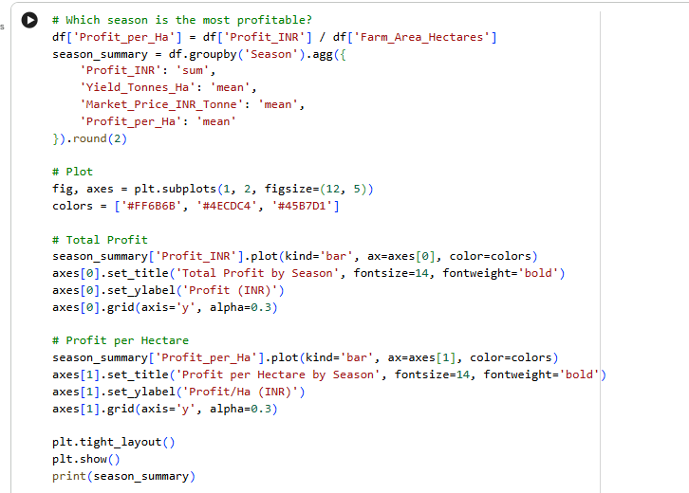
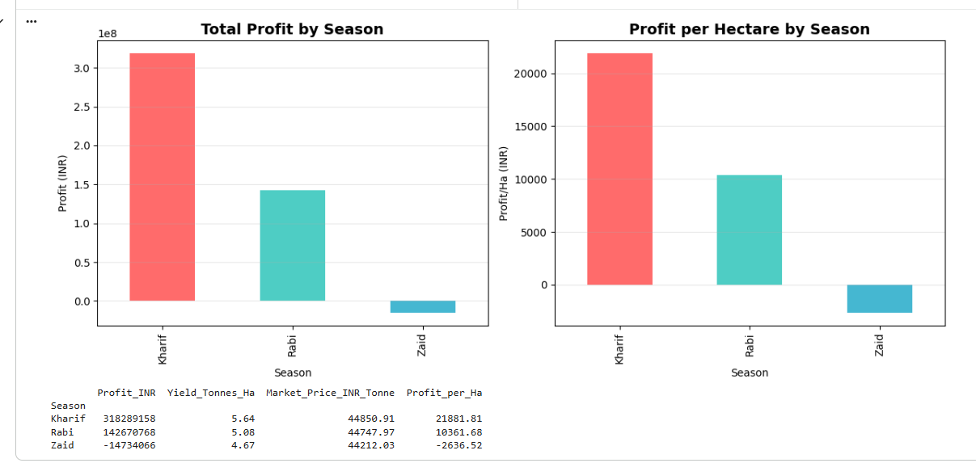
RESULTS

Slide 8
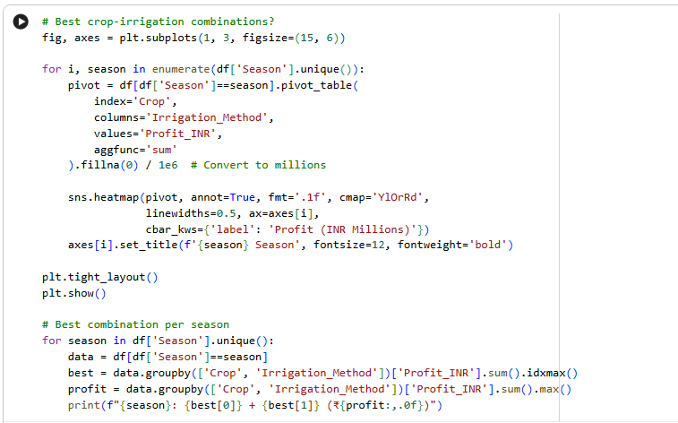
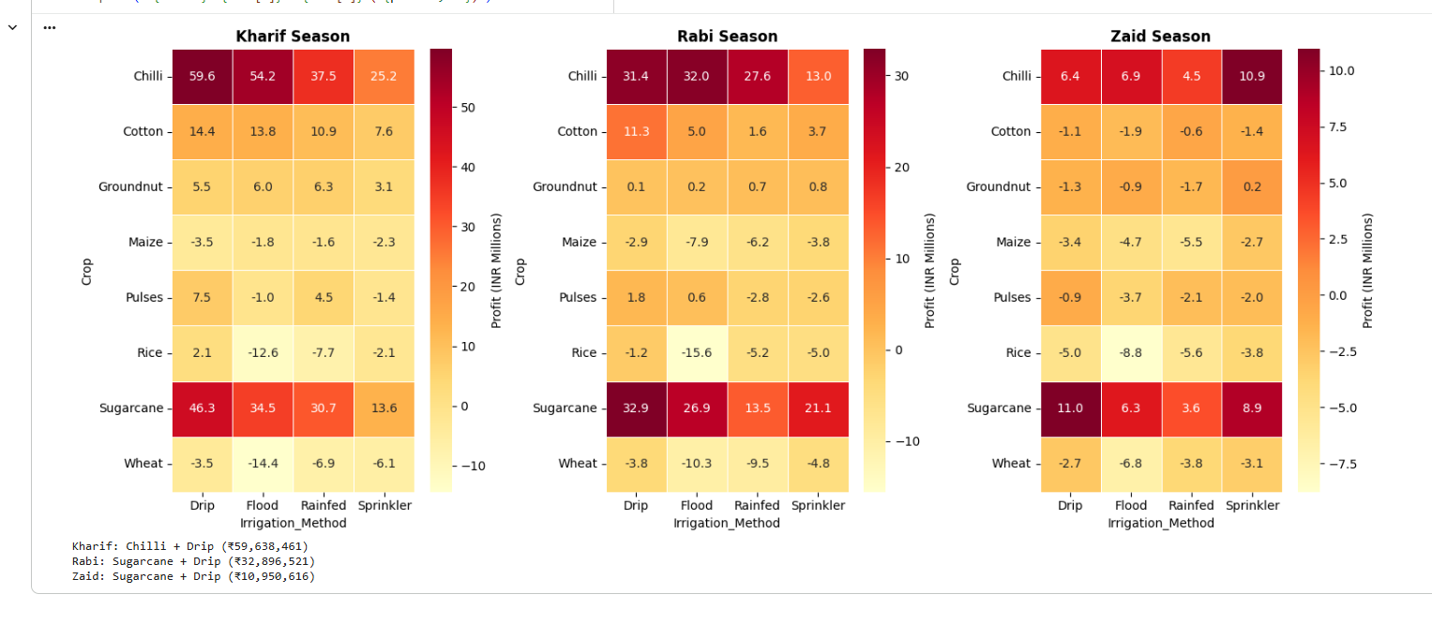
RESULTS

Slide 9
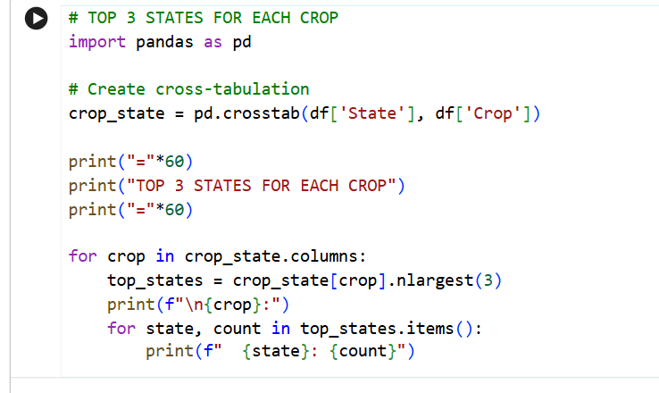
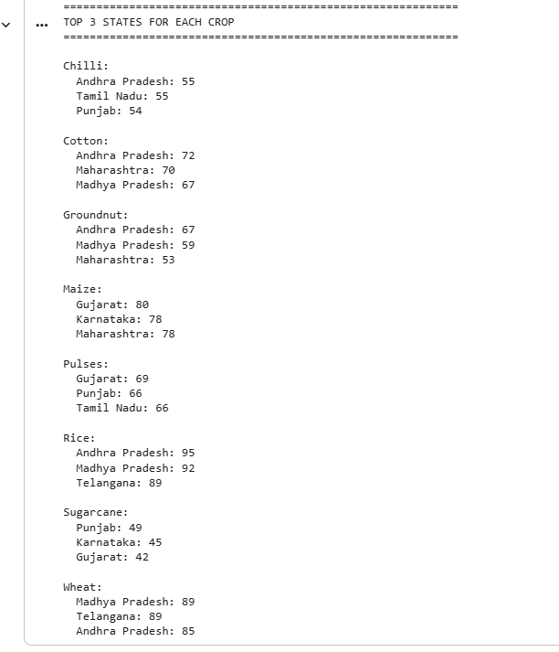
RESULTS

Slide 10
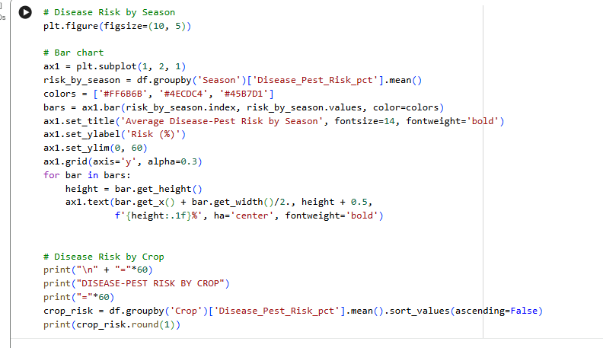
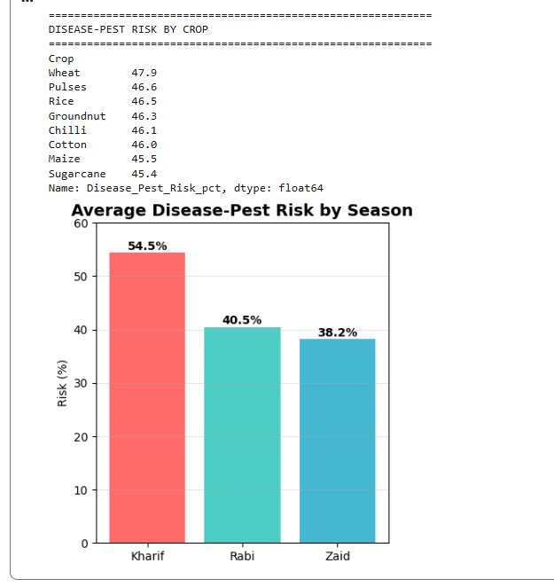
RESULTS
[Add screen shots of your code ]

Slide 11
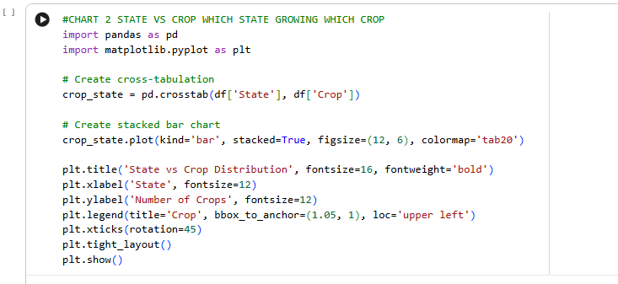
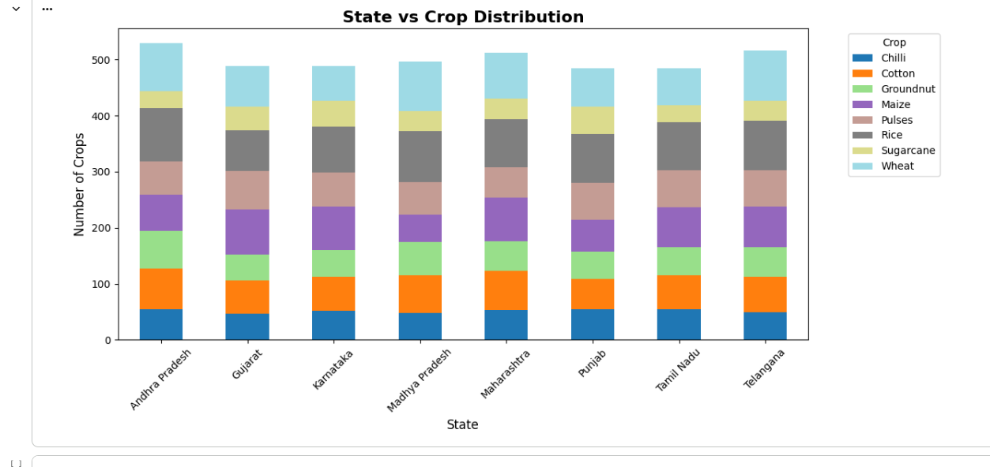
RESULTS

Slide 12
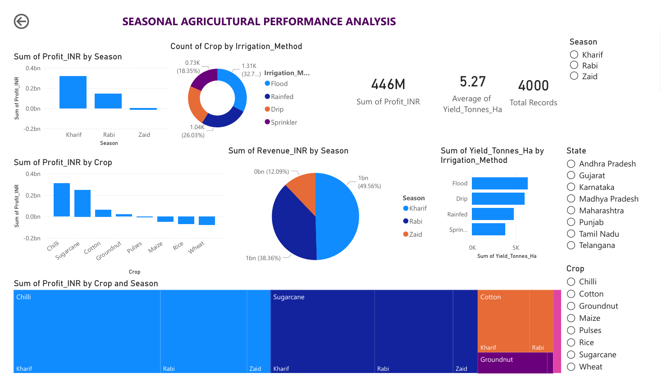
Seasonal Agricultural Performance Dashboard

Slide 13
Business Insights
1.Insight 1: Kharif Season Dominates Profitability
Kharif generates ₹318.3M profit vs. Zaid's loss of ₹14.7M
2.Insight 2: Chilli & Sugarcane are Top Crops
These two crops significantly outperform staples like Rice and Wheat
3.Insight 3: Flood Irrigation is Common but Inefficient
Most widely used method but Drip/Sprinkler show better yield efficiency
4.Insight 4: Zaid Season is Resource-Inefficient
Lowest water efficiency (4.41) despite highest water usage (6420 m³)
5.Insight 5: Management Practices Matter More Than Weather
Very weak correlation between environmental factors and yield

Slide 14
Business Recommendation
Recommendation 1: Implement "Kharif-Focus, Zaid-Optimize" Strategy
Action: Allocate majority of resources to Kharif season
Action: For Zaid, pilot high-value, low-water crops with Drip irrigation
Justification: Capitalizes on Kharif profitability while mitigating Zaid losses
Recommendation 2: Launch "High-Value Crop & Efficient Irrigation" Program
Action: Promote Chilli and Sugarcane in optimal states
Action: Subsidize Drip and Sprinkler irrigation adoption
Justification: Addresses both revenue (high-margin crops) and cost (resource efficiency)

Slide 15
Future scope
AI-Powered Crop Recommendation System
IoT Sensors for Real-Time Farm Monitoring
Smart Irrigation & Precision Farming
Mobile App for Farmers (Crop Advisor + Market Info)
Climate Change Impact Assessment
Supply Chain & Price Forecasting
Data-Driven Agricultural Policy Support
Farmers' Knowledge Sharing Platform
Disaster Risk Management (Drought, Flood)
Export Market Analysis & Global Opportunities
Automated Pest & Disease Detection using AI

Slide 16
GitHub Link
Seasonal_agriculture_analysis

Slide 17
Thank you
.
.

